Slide 1
Automated Hyperspectral Pyrometry of Bulk Crystal Growths
Naman Parikh¹, Tyrel McQueen^{3,4,5,6}, David Elbert^{2,3}
¹Carnegie Mellon University, ²Institute for Data Intensive Engineering and Sciences, ³Hopkins Extreme Materials Institute, ⁴JHU Department of Materials Science and Engineering, ⁵JHU Department of Chemistry, ⁶Institute for Quantum Matter

Slide 2
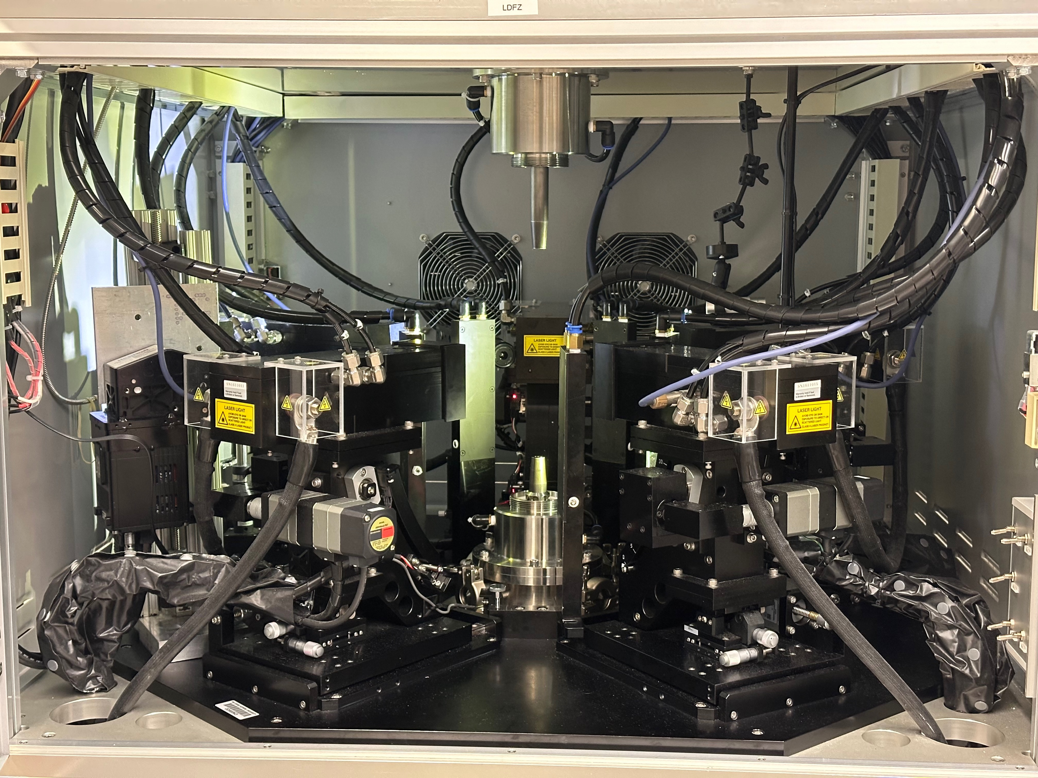
Laser Diode Floating Zone
Replace with picture that includes someone

Slide 3
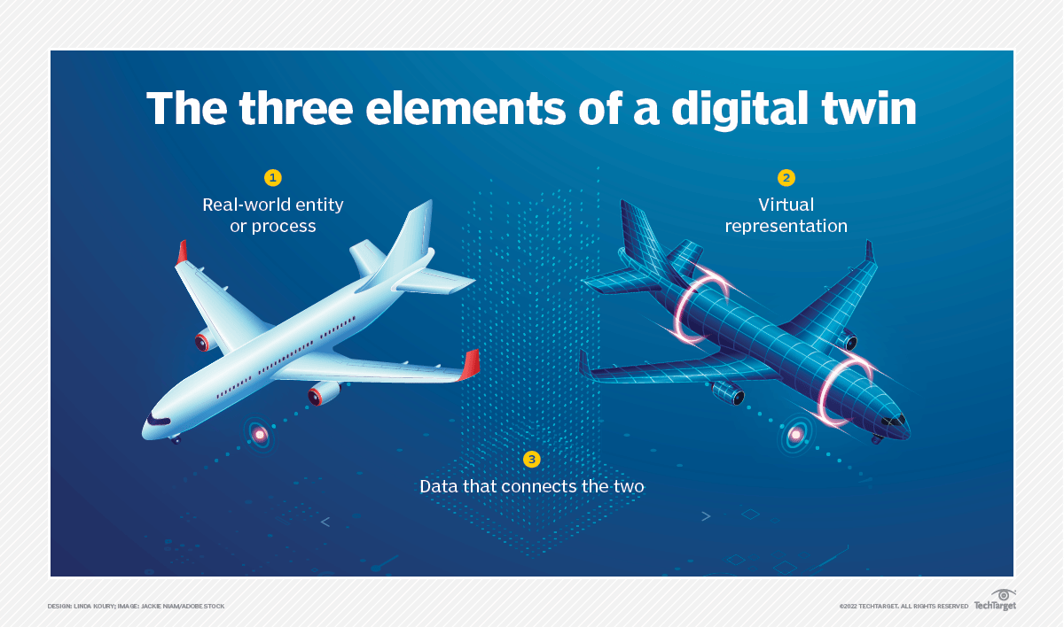
Digital Twins

Slide 4
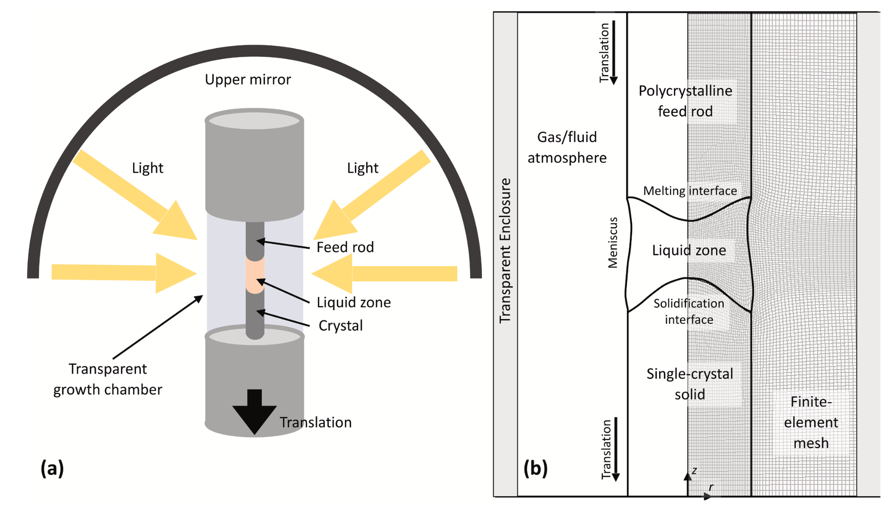
Scott S. Dossa, Jeffrey J. Derby
https://doi.org/10.1016/j.jcrysgro.2022.126723

Slide 5
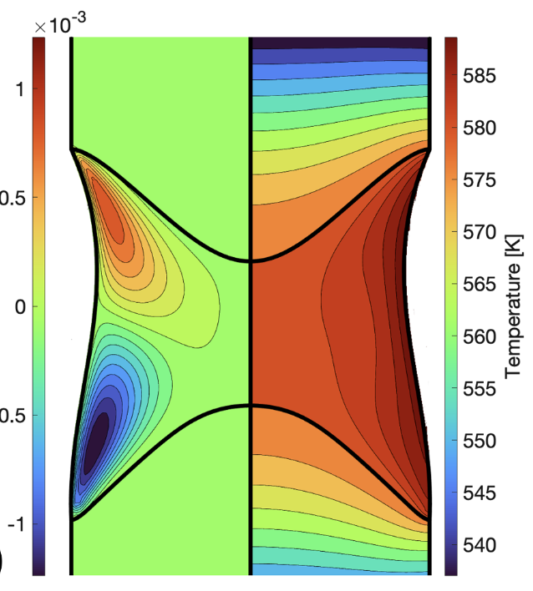
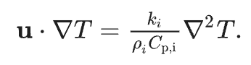
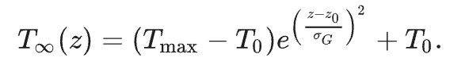
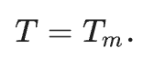
Modeling – NaNO₃
Scott S. Dossa, Jeffrey J. Derby
https://doi.org/10.1016/j.jcrysgro.2022.126723
5
Notes:
How does this modeling work? How is it treating temperature?
Talk about what is missing from this modeling – to make a digital twin we need actual experimental data to validate it
This takes temperatures as an input, so it’s like starting in the middle of a growth with know temperature field rather that from the beginning of the growth
Since temperature distribution is an input, IF I WANT TO USE THE MODEL FOR MY GROWTH, I need some way to measure the temperature distribution so I can then input it into the model – I need a way to collect this data
I also need a way to collect temperature distribution data to validate this model
Temperature is a critical parameter that is missing from these models

Slide 6
Research Question
How can we collect temperature data from lab growths?

Slide 7
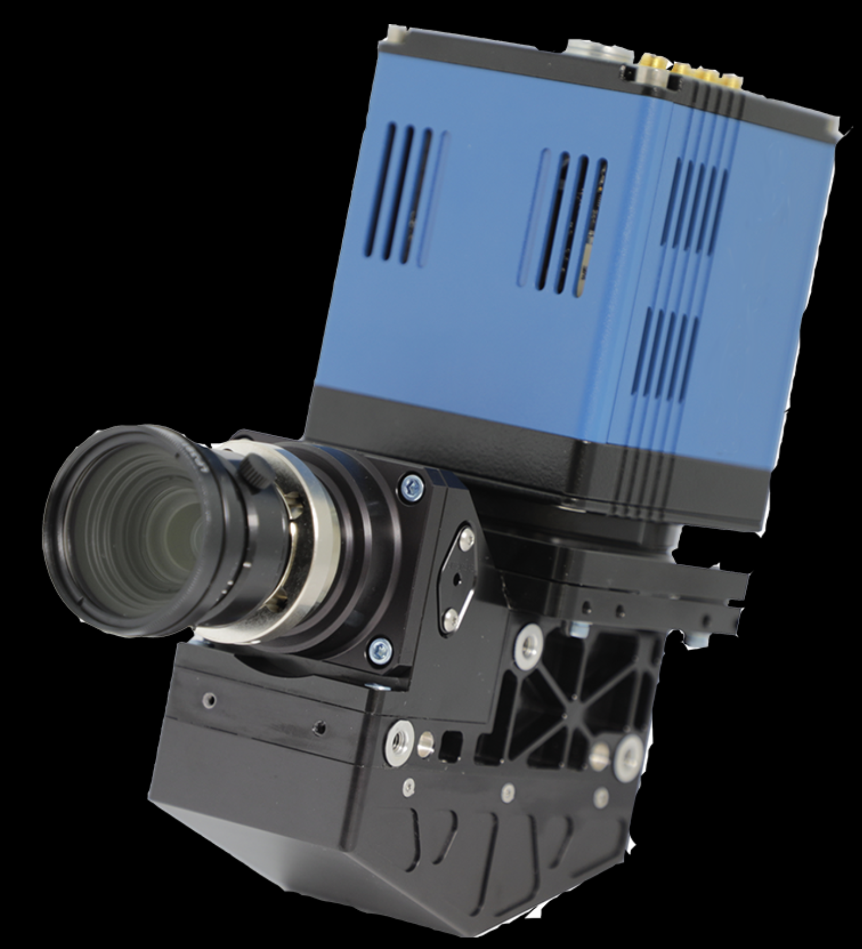
Hyperspectral Camera
Notes:
This is a hyperspectral camera. Ours is unfortunately not blue but that’s ok. It is a camera that measures hyperspectral data, which means intensity values at hundreds of wavelengths. This allows us to image an entire spectrum for each pixel.

Slide 8
What are the steps?
Collect data
Notes:
Obviously

Slide 10
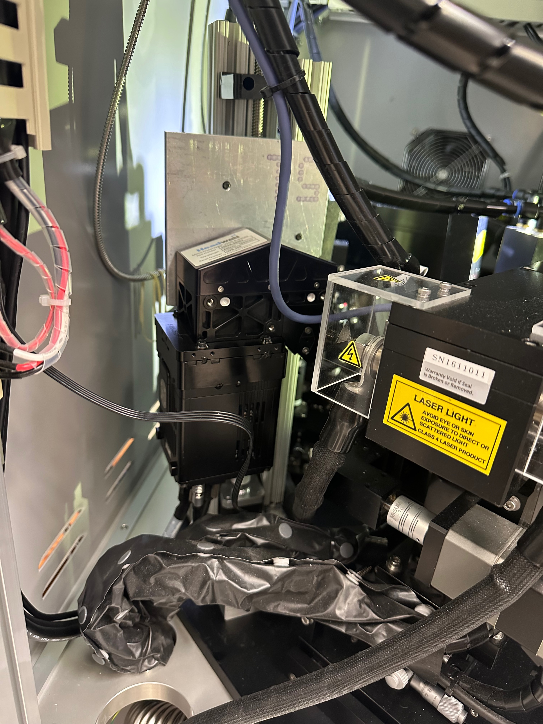

Slide 11
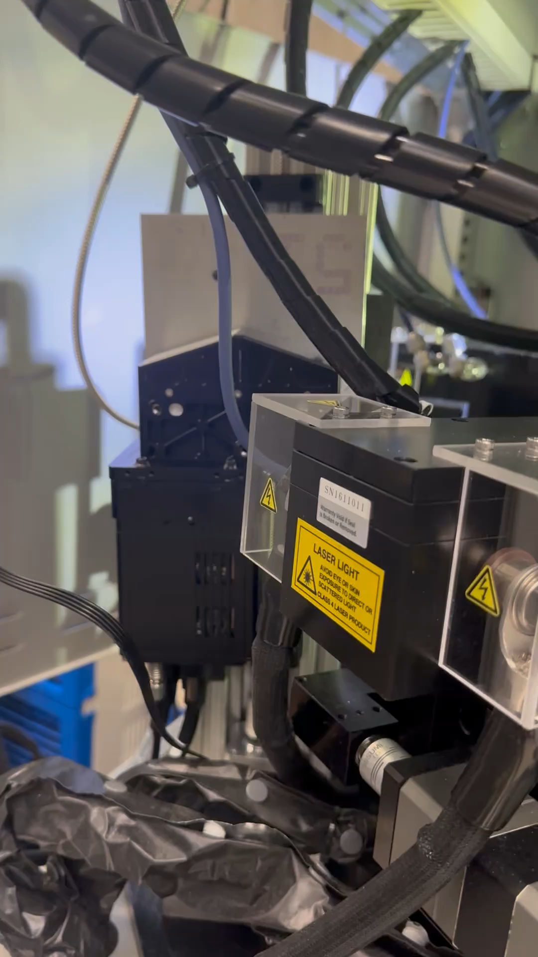

Slide 12
What are the steps?
Collect data
Analyze the data
Notes:
We need some way to determine the temperature from the hyperspectral data, which will take some physics and machine learning to do

Slide 13
What are the steps?
Collect data
Analyze the data automatically
Notes:
We want to ultimately collect a lot of data and collect it regularly, so we would like to automate this process to make it faster and easier. If we had robots that automatically took a sample out of the furnace, put it through an XRD analysis, and spit out the ready-to-analyze results, things would be much faster. This is the same idea; we have the computers automatically grab images as they come, analyze them, and spit out the result that we want to look at

Slide 14

OpenMSIStream!
Diagram for openmsistream
Notes:
This is the software with which we stream data from lab equipment. What is data streaming? When some data is collected, it is automatically streamed from the machine where it was collected and can be received (or consumed) by any other machine. For our use, this includes data storage servers and servers on which the data is analyzed. The result of the analysis is then also stored and streamed back to the machine where it was collected for the experimenter to see

Slide 15
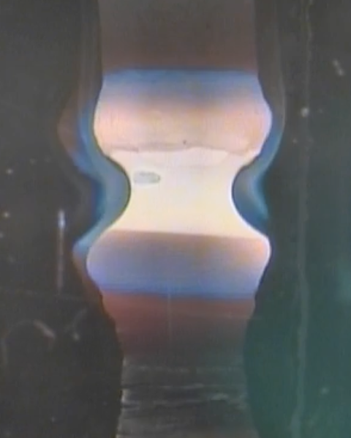
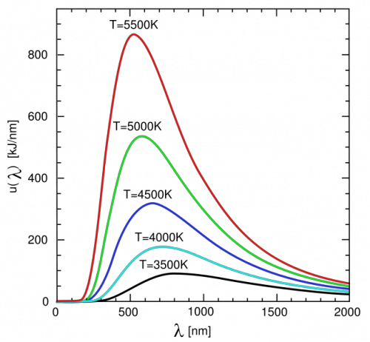
Analysis
Blackbody
Notes:
The great thing about blackbodies is that their emission spectra are very dependent on their temperature. So, the spectrum at each pixel in a hyperspectral image, when interpreted as blackbody radiation, contains the necessary information to determine its temperature

Slide 16
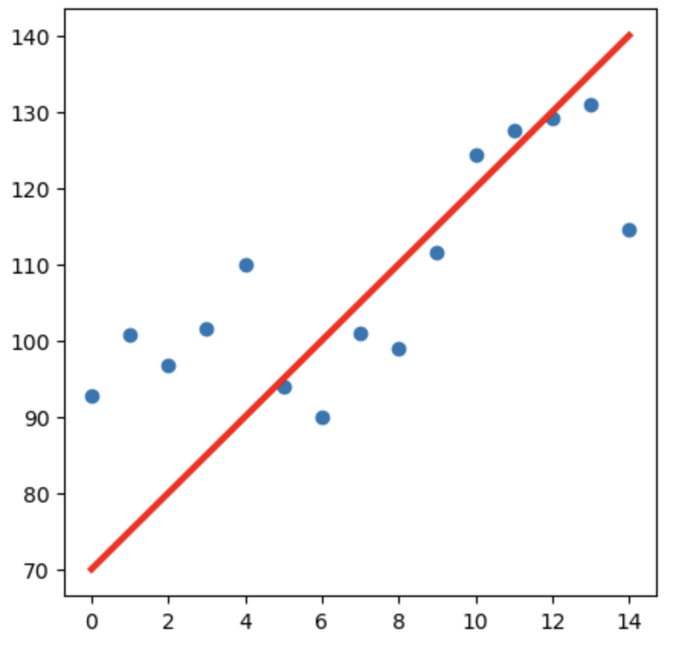
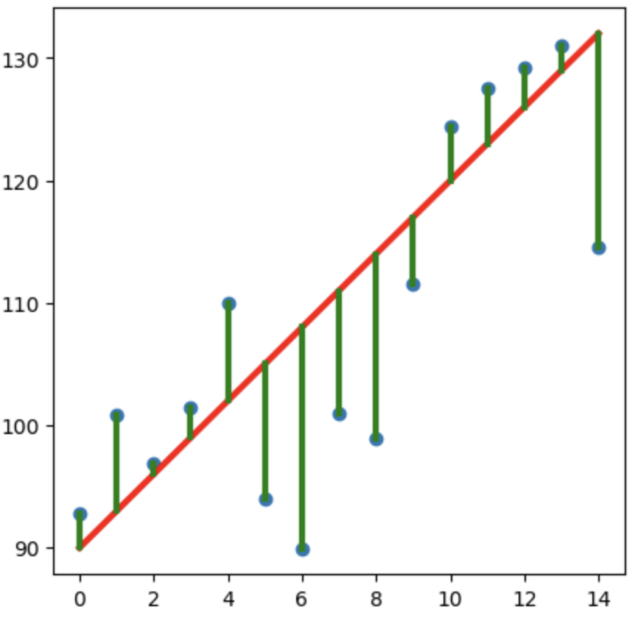
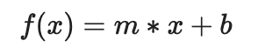
Least Squares Regression
Model Function
Guess Parameters
Minimize Residuals
Parameters
Notes:
The great thing about blackbodies is that their emission spectra are very dependent on their temperature. So, the spectrum at each pixel in a hyperspectral image, when interpreted as blackbody radiation, contains the necessary information to determine its temperature

Slide 17
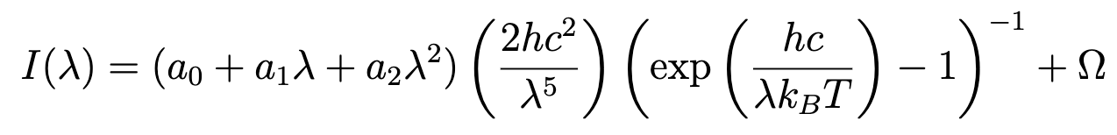
Blackbody Model Function
Emissivity
Stray Light Offset
Parameters
Notes:
Notice that everything that isn’t a parameter is either a constant or the independent variable wavelength

Slide 18
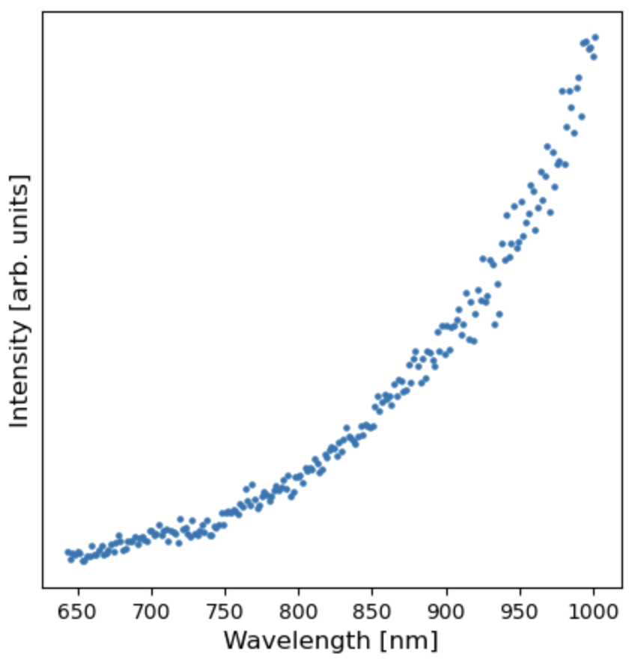
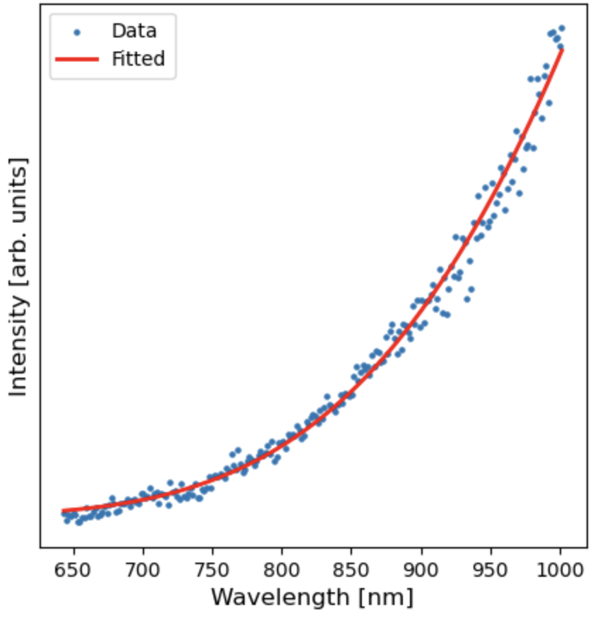
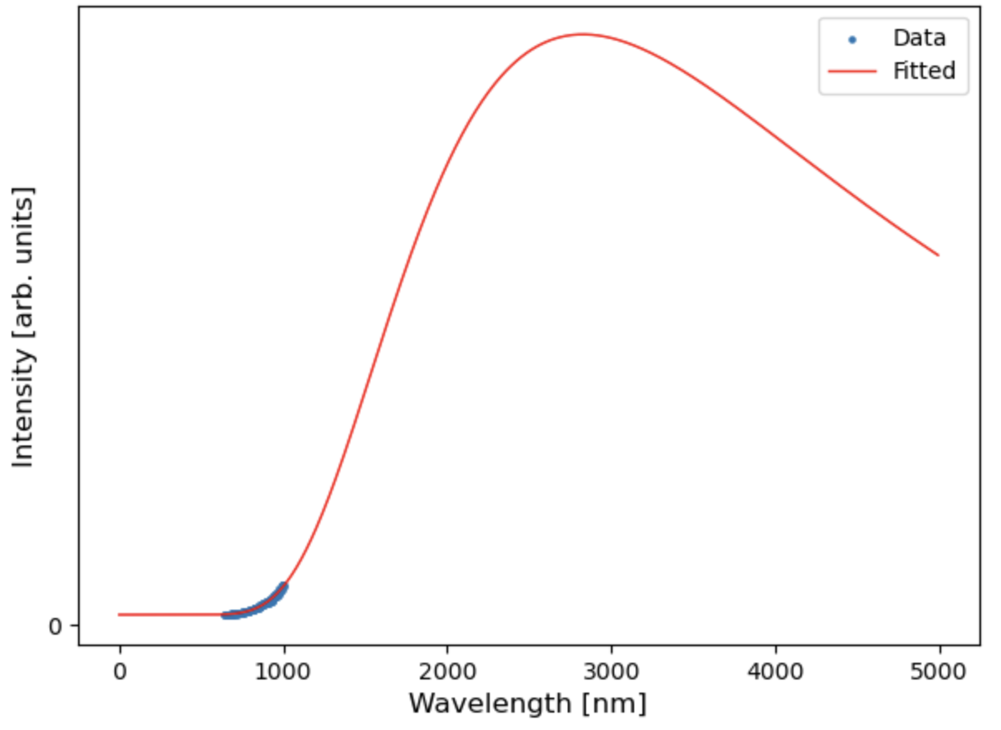
Run the Regression
Data
Fitted with T=1298 K
Full Spectrum

Slide 19
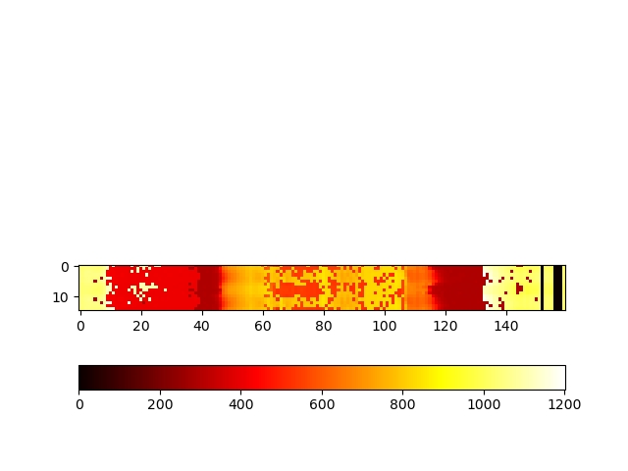
Into the furnace
Kelvin
19

Slide 20
What’s next?
Optimizing the analysis
Collect tons of data
Validate and inform models
Notes:
Optimizations include performance improvement and potentially needing to reduce sensitivity to atomic emission spikes

Slide 21
Acknowledgements
Evan Crites (McQueen Lab, PARADIM)
Maggie Eminizer (IDIES)
NSF Awards #2039380 (PARADIM) and #2129051 (VariMat)
Kelvin

Slide 22
Extra Slides – Camera Motion

Slide 23
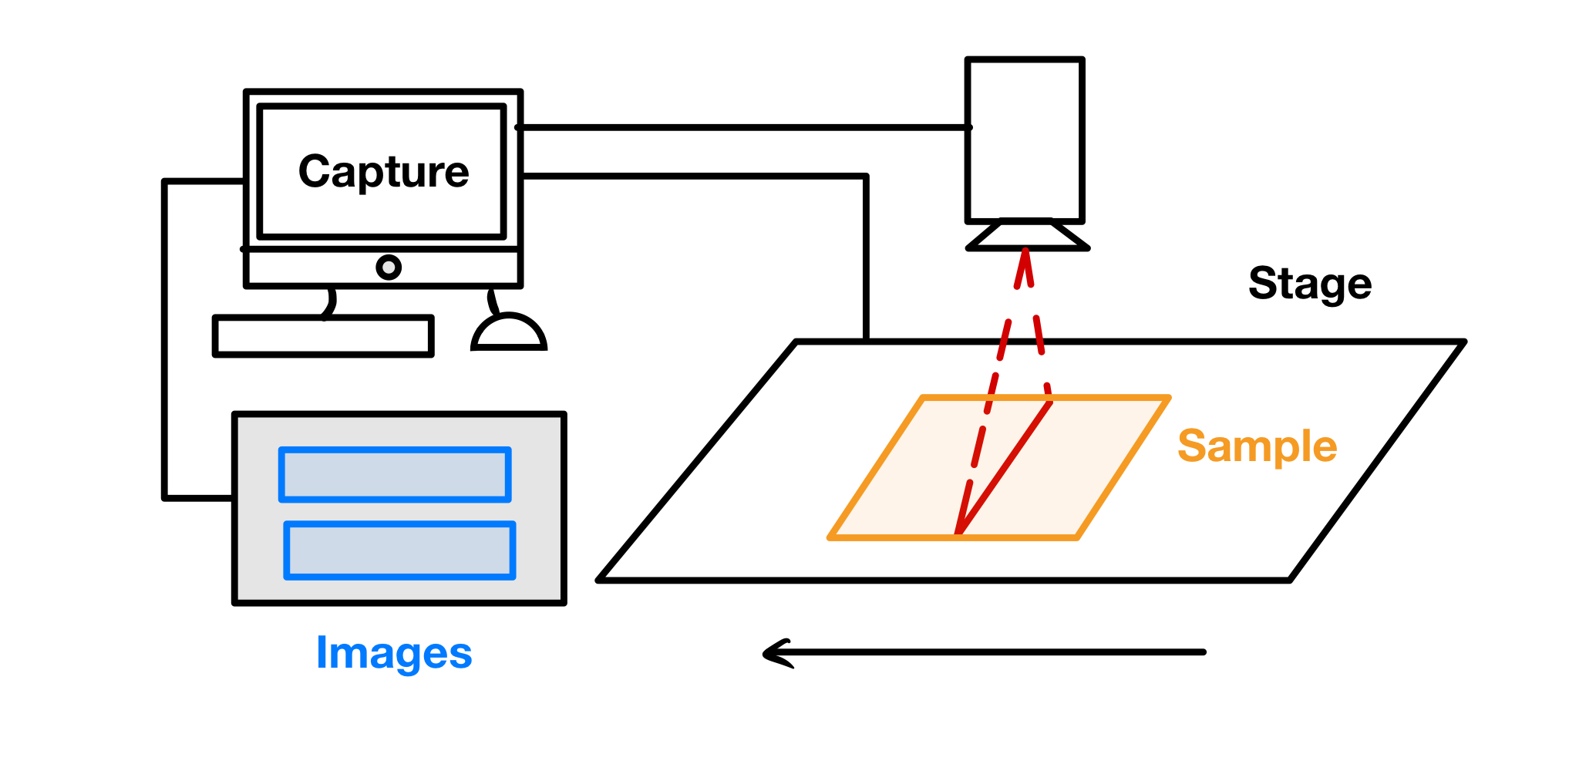
Notes:
Why does it need to move?
Important to note that the computer syncs the start of the image capture and the movement of the stage

Slide 24
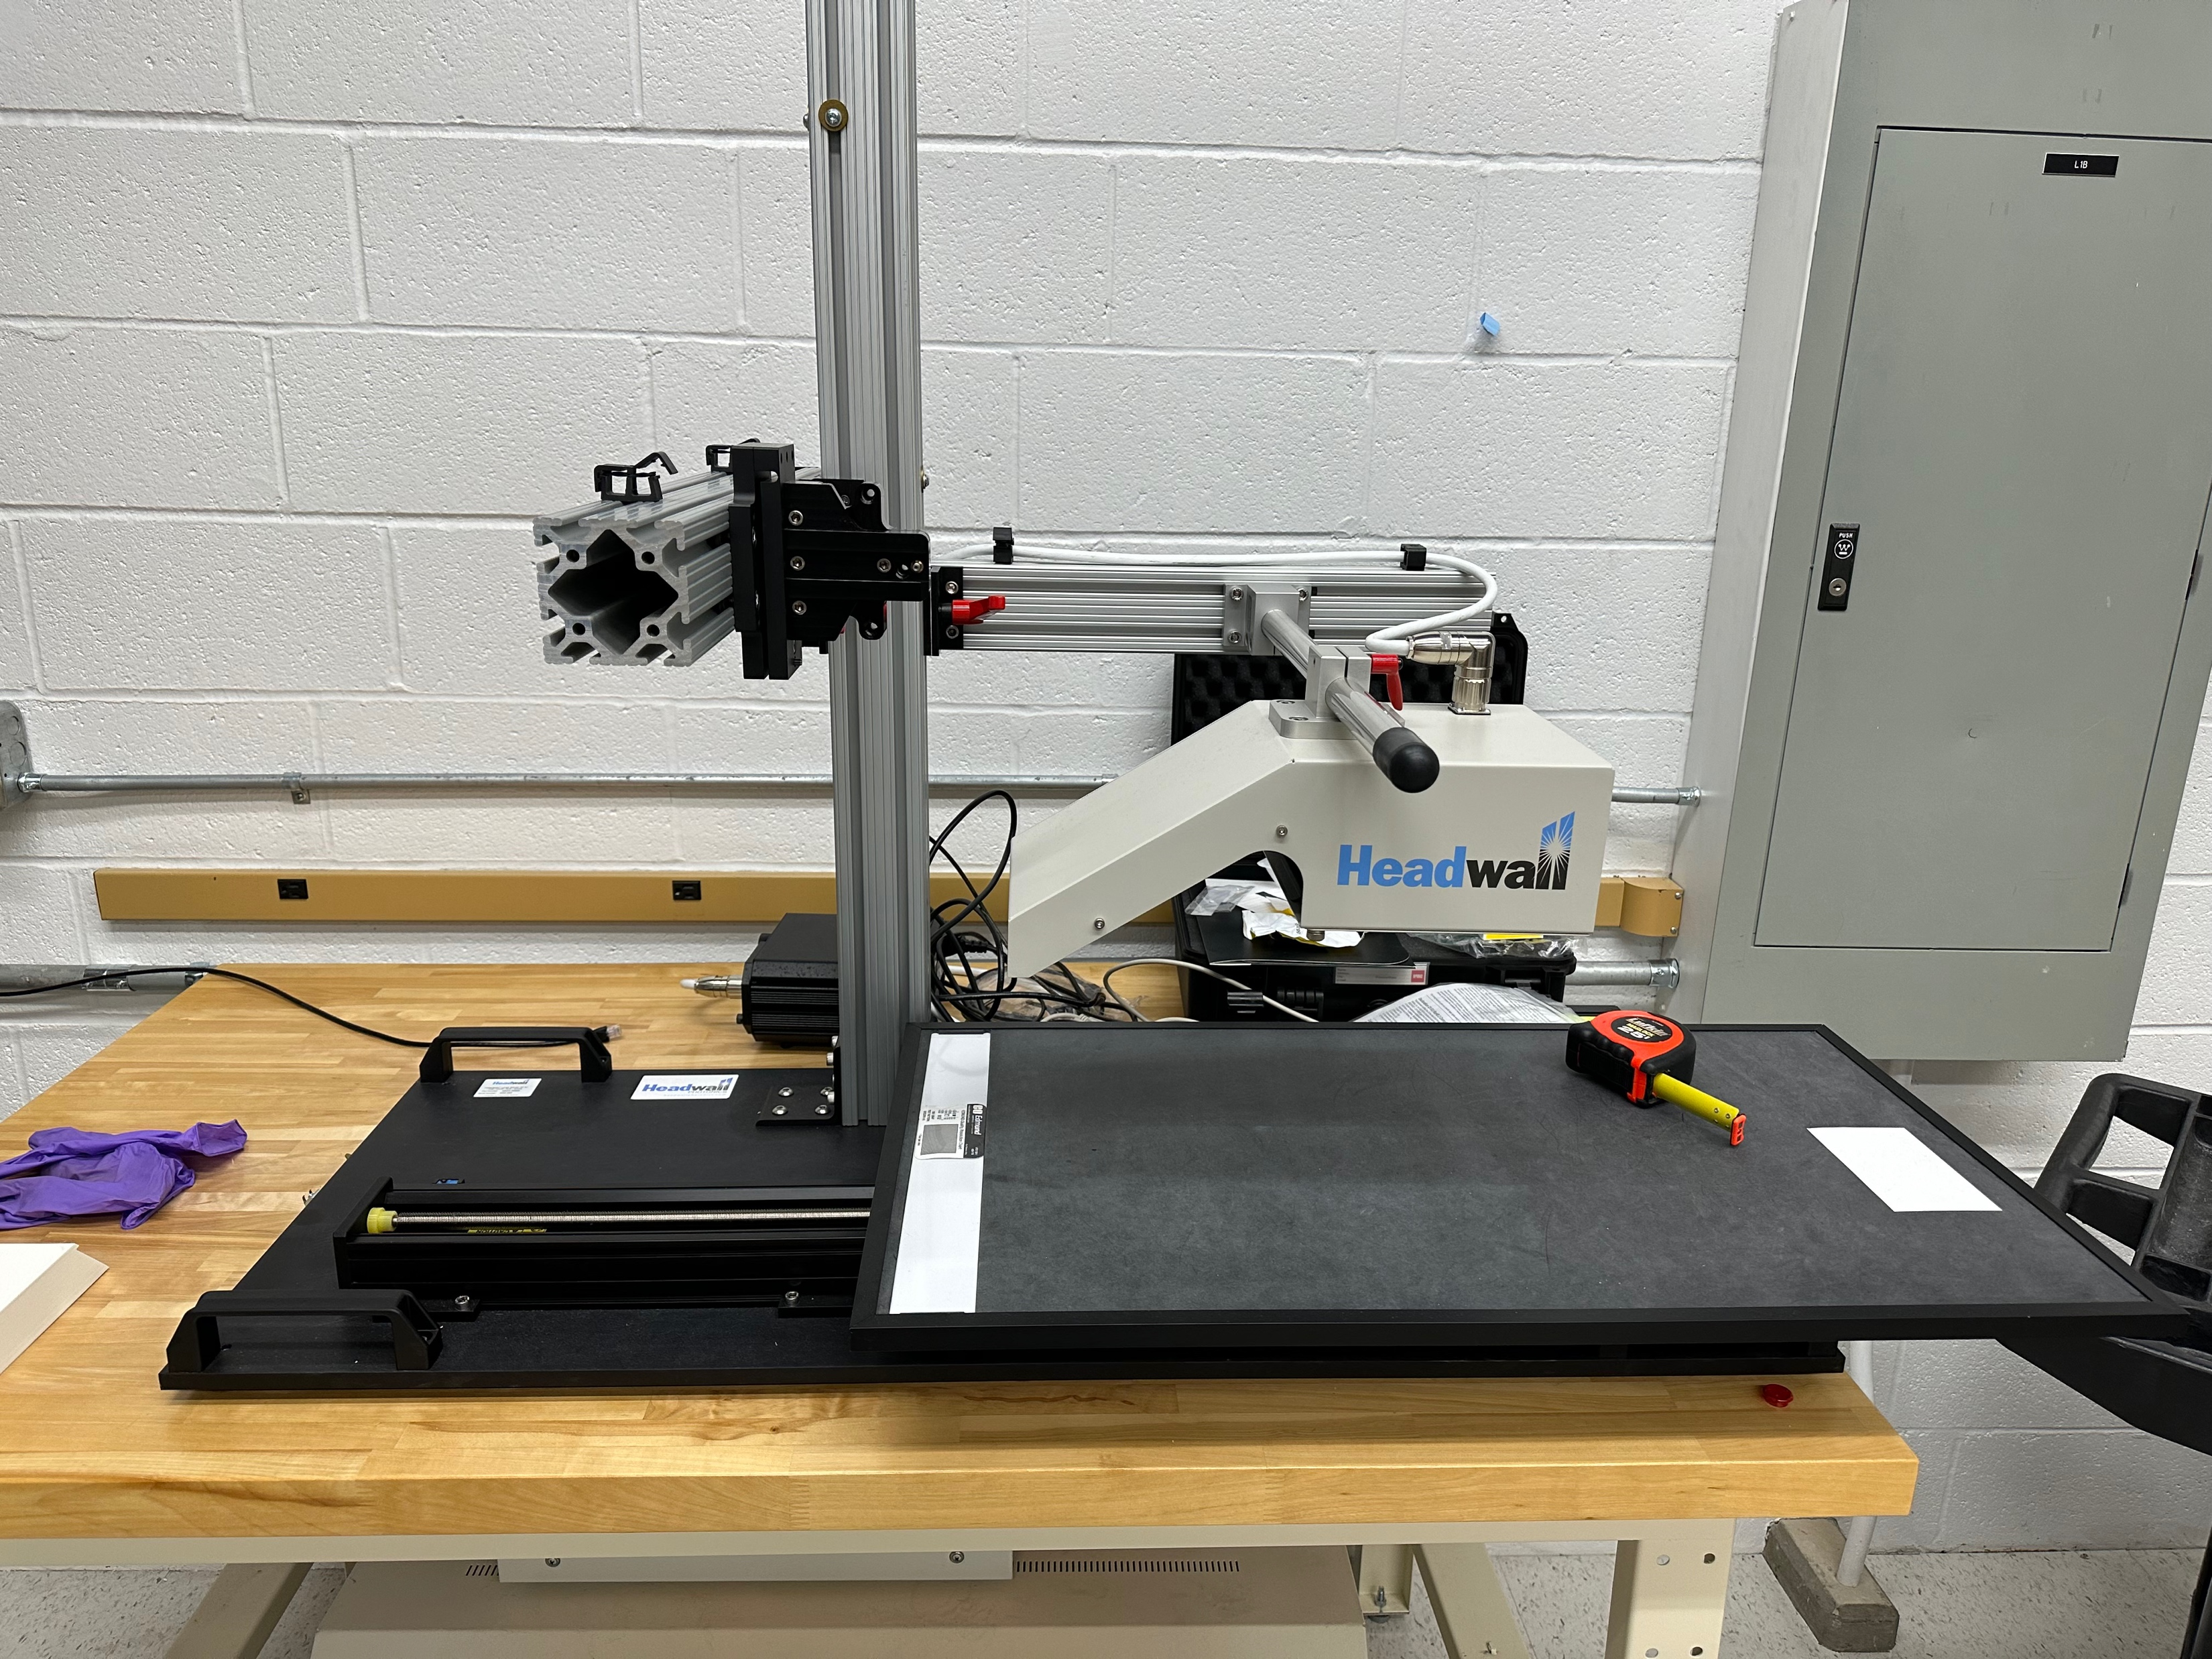

Slide 25
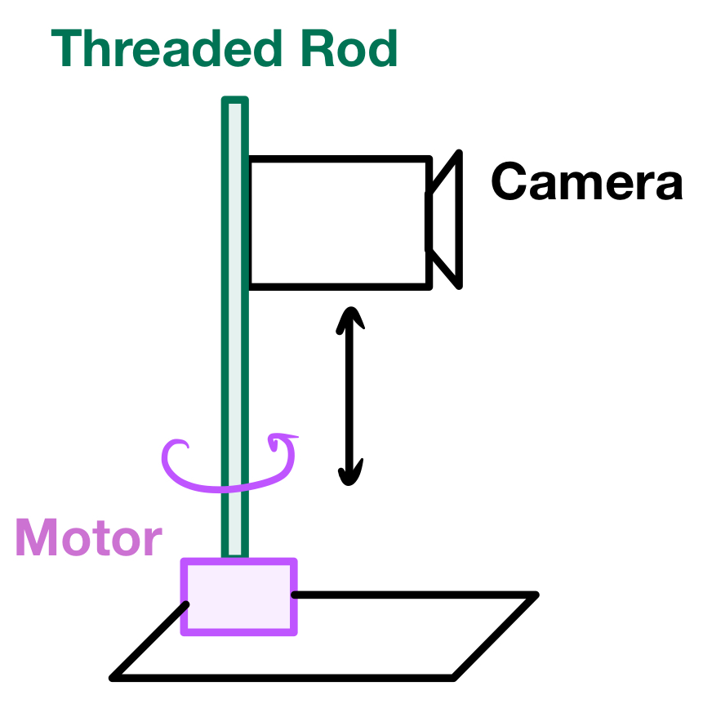
Notes:
How do we make it scan?

Slide 26
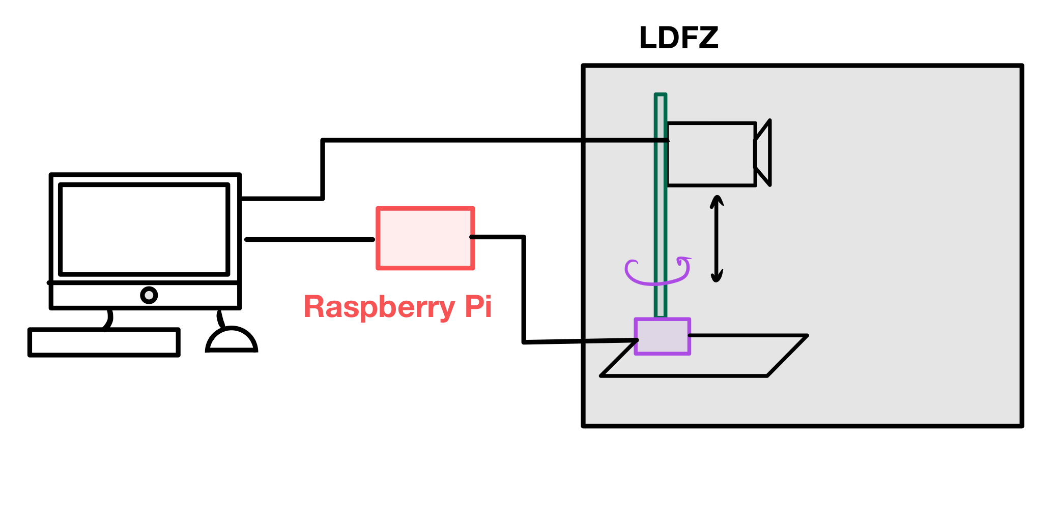
Notes:
How do we sync the motor with the image capture? We are replacing the stage with the motor

Slide 27
Extra Slides – Streaming

Slide 28
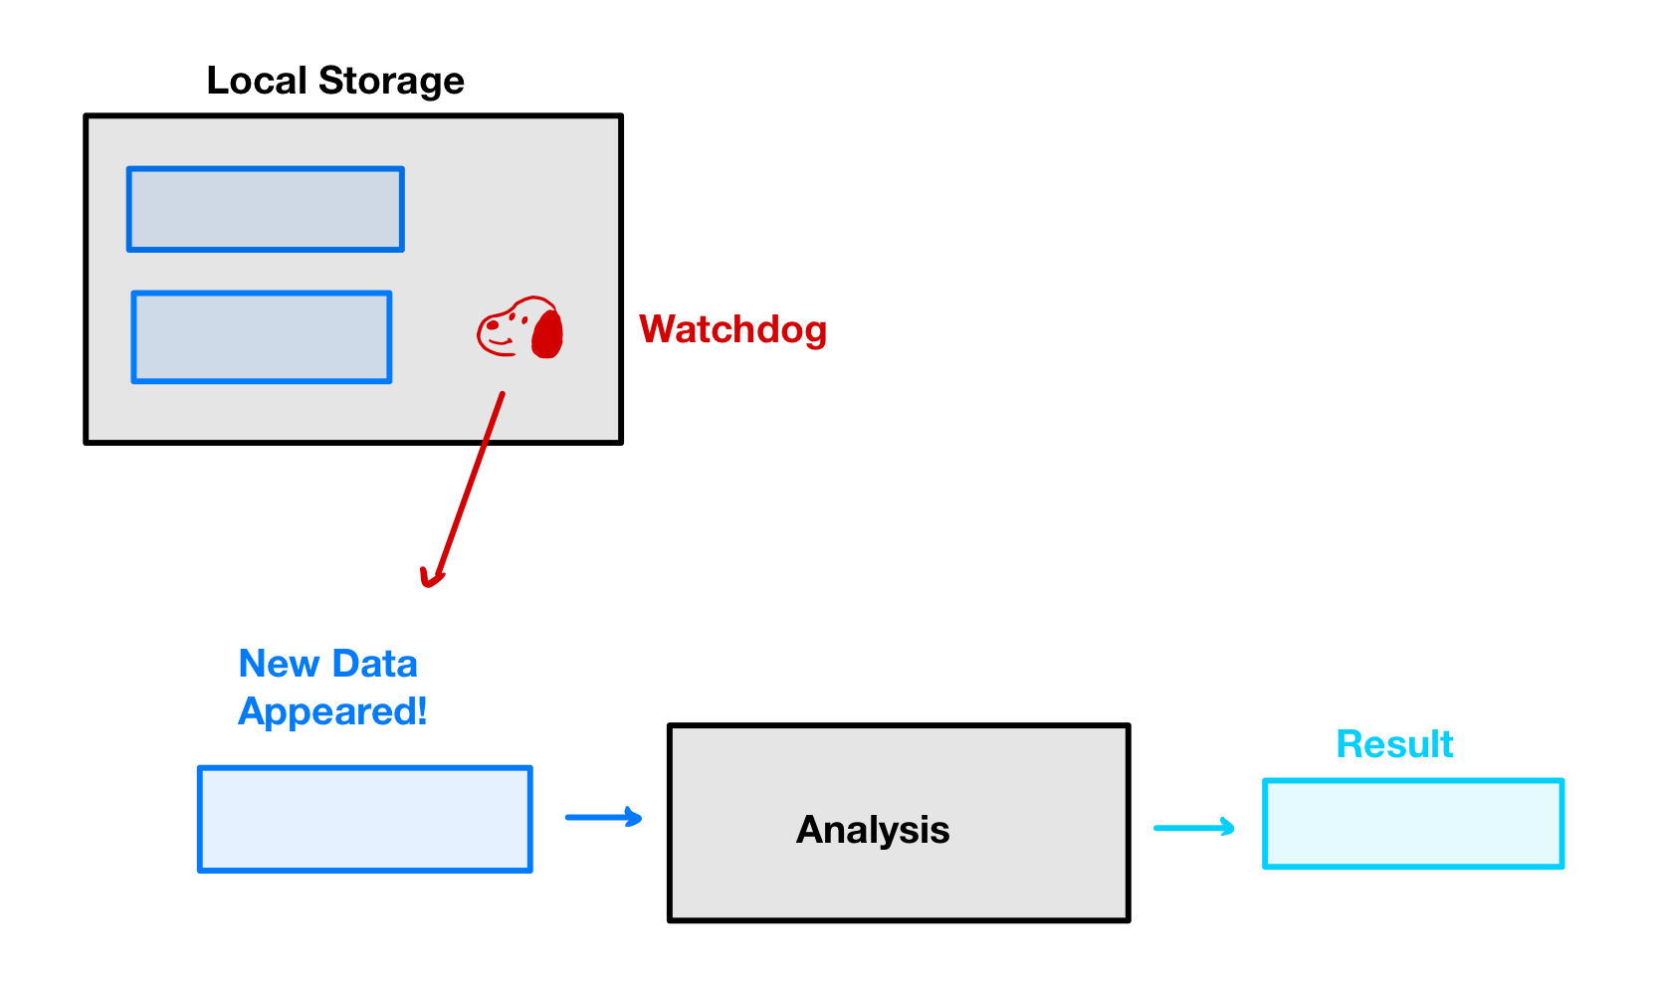

Slide 29
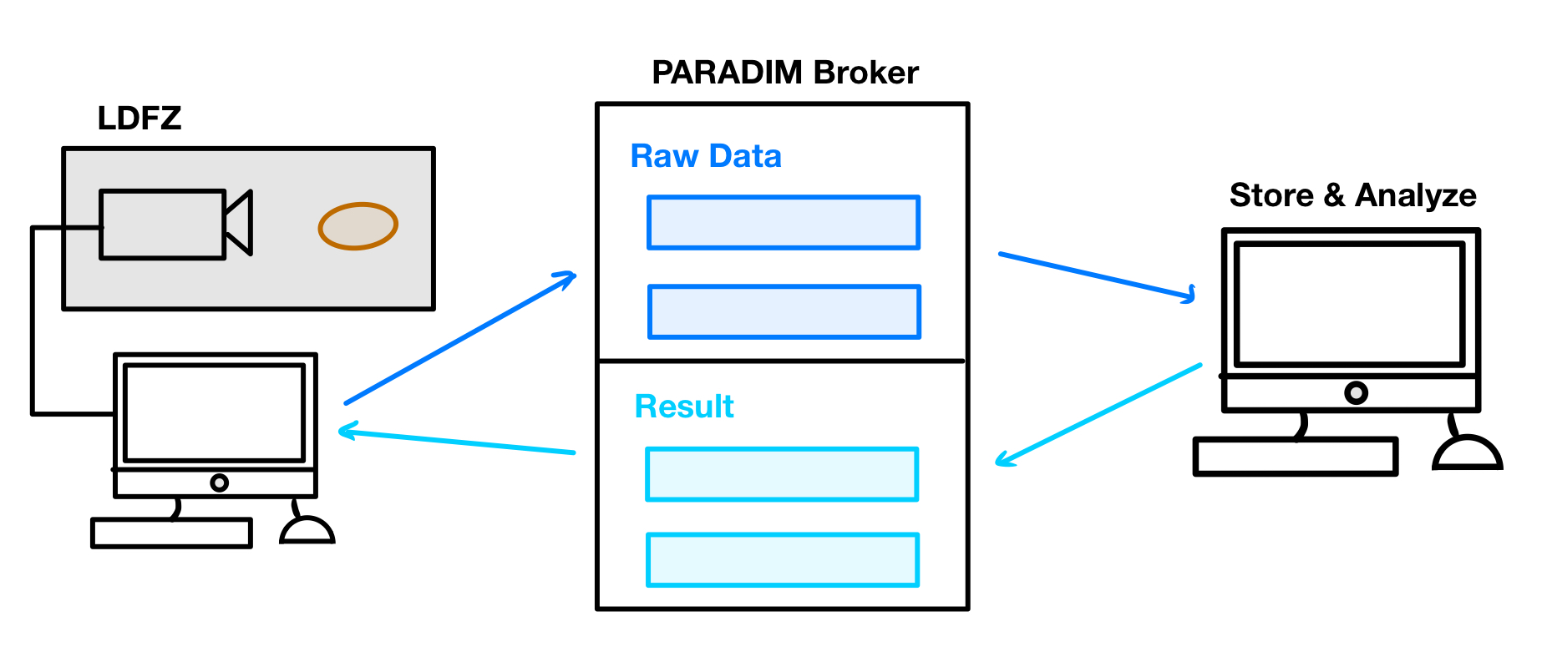
Notes:
Animate in one piece at a time

Slide 30
